Slide 1
OHgrievance
Notes:
Thank you for your interest in the OHgrievance filing system.

Slide 2
What is OHgrievance?
Electronic system that will allow bargaining unit employees and representatives to file and track grievances
Agency Human Resources designees will respond in this system after meeting with impacted personnel
System will send notifications of actions taken to each grievance
Union representatives may propose grievances to be heard at mediation and arbitration
Union representatives may submit issues or questions regarding the system to the system administrator
Notes:
OHgrievance is an electronic system that will allow bargaining unit employees and representatives to file and track grievances in a centralized location.
Agency Human Resources designees will receive notification of new and appealed grievances, contact designated employees and union representatives to discuss the grievance and respond in this system.
The system will send email notifications of actions taken to each grievance.
Additionally, union representatives may withdraw or propose grievances to be scheduled for mediation and arbitration where applicable.
Furthermore, union representatives may submit issues or questions regarding the system functionality to the system administrator at the Office of Collective Bargaining (OCB).

Slide 3
Why OHgrievance?
One system for all unions, agencies and OCB
Minimize time spent recreating facts of grievance
Minimize time and money spent tracking grievances in multiple forums
Consistent set of information
Notes:
The unions that represent state of Ohio employees in specific bargaining units as well as their agency management counterparts and the Office of Collective Bargaining recognized the value of having an electronic forum where all grievances could be filed, tracked and responded to. All parties worked together to build the necessary components to support such a system.
Having one system will minimize the time spent recreating facts of the grievance, as well as the time and money spent tracking grievances in multiple forums.
Most importantly, one system will lead to a consistent set of information, facilitating tracking and scheduling while improving communication between all parties.

Slide 4
Website Address
OHgrievance.ohio.gov
Notes:
Union employees and representatives will file grievances at OHgrievance.ohio.gov.

Slide 5
When logging in for the first time, please select “New User”
Notes:
When logging in for the first time, the union employee or representative (the user) will select the “New User” link.

Slide 6
New User
Must enter State of Ohio User ID
Must enter the recognized State of Ohio Email address
If email address submitted is not recognized as email on OAKS, an error message will advise the user he/she cannot file and to contact union representative
If user does not have an email address, an error message will advise the user he/she cannot file and to contact union representative
Must create a password that is 8 characters long
Notes:
Please note that the user is not logging into myOhio.gov (OAKS).
That being said, the user must enter his or her State of Ohio User ID and a recognized State of Ohio Email address.
If the user attempts to enter an email address that is not recognized as his or her work email address of record, an error message will advise the user that he/she cannot file and must a contact union representative.
Additionally, if a user does not enter an email address, an error message will advise the user that he or she cannot file a grievance and to contact a union representative.
User will also be asked to create a password. When creating the password, the user must ensure it is 8 characters long.

Slide 7
Forgot Password?
Click on “Forgot Your Password”
Notes:
Please know that should a user forget his or her password, he or she may select “Forgot Your Password”

Slide 8
Forgot Password?
Enter STATE OF OHIO ID and click submit
Notes:
The system will ask the user to submit a State of Ohio User ID.

Slide 9
Forgot Password?
Temporary password will be sent to State of Ohio email address
Return to Login page
Notes:
A temporary password will be sent to the work email on record.
The user can then return to the system and use the temporary password to access the system and set a new password.

Slide 10
Grievances Home Screen
Home screen will display all recently viewed, created or modified grievances the user has authorization to see.
User can select which view they prefer by selecting from the drop down menu
User must always select “Go” to refresh as the screen that first comes up will not show all items.
Notes:
Upon successfully logging into OHgrievance, a Home screen will display all recently viewed, created or modified grievances the user has authorization to see.
The system is set to allow union employees to see all grievances he or she has personally filed or the union has filed on their behalf.
The system will allow union representatives to see all grievances filed within their worksite or chapter.
All users may select which view they prefer by selecting from the drop down menu on the right hand side of the screen.
Please note that regardless of types of grievances the user wishes to see, the user must always select “Go” to refresh and reflect the most current information.

Slide 11
List Views
User must always select “Go” to refresh.
User can further filter grievances selecting a “List View”
All Open grievances
All Closed grievances
All Termination grievances
All Discipline grievances
All Issues grievances
All Working out of Class grievances
All grievances at Step 1
All grievances at Step 2
All grievances at ADR (mediation or NTA)
All grievances at Arbitration
Notes:
The user may further filter out the grievances they wish to see by selecting a specific “list view.”
These list views allow the user to see only open or closed grievances, types of grievance or grievances at specific steps in the appeal process.

Slide 12
Summary of Cases
User may sort grievances listed on screen by clicking on the title of the column.
Created Date Grievance Number
Submission Date State of Ohio ID
Grievant’s Name Status
Record Type (Step) Management/Arb Response
Union/Member Action
Notes:
The user may also choose to sort grievances listed on screen by clicking on the title of the column they wish to sort.

Slide 13
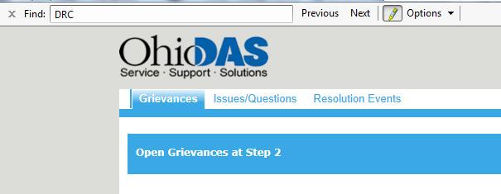
Searching for Grievance
User may click on “CTRL” “F” to search for specific information (e.g., grievant name, agency, etc.)
Be sure to use the “show me more” option at the bottom of the page to expand your list.
Notes:
Additionally, the user may search for specific information by clicking on “CTRL” “F” and entering the search criteria such as grievant name or agency.
Please note that when there are numerous records, the should ensure that he or she selects the “show me more” option at the bottom of the page to expand the list.

Slide 14
Creating a Grievance
Notes:
A user can file a grievance by clicking on the “Create Grievance” link in the middle of the Grievances screen.

Slide 15
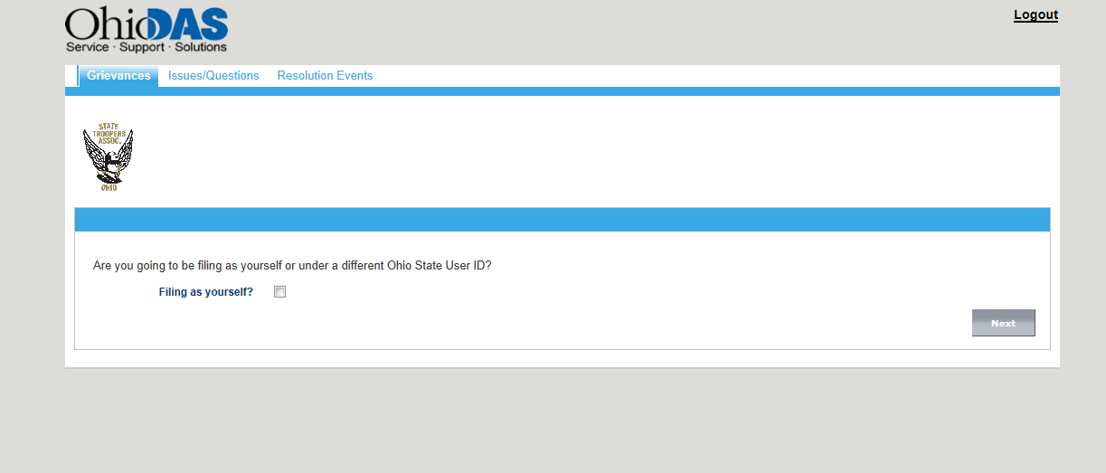
Creating a Grievance
Applicable Union Logo should appear
If user is an authorized Union Representative (e.g., steward, delegate, associate, etc.), the system will allow the option to file for another
Notes:
At this point, the applicable Union Logo of the person logged into the system should appear.
If the user is an authorized Union Representative such as a steward, delegate or associate, the system will allow the option to file for another by asking if the user is “Filing as yourself?”

Slide 16
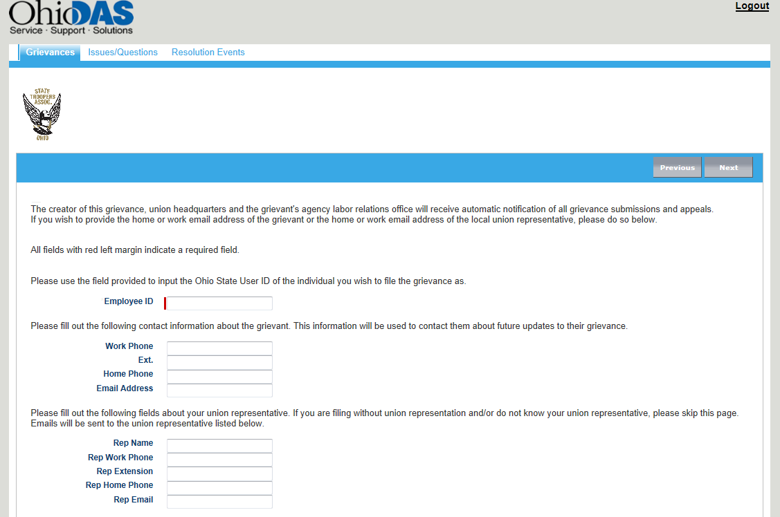
If a union representative is filing for another member, he/she must indicate member’s State of Ohio ID.
Notes:
If a union representative does not select “Filing as Yourself”, the system will assume he or she is filing for another member.
The system will then require that the user indicate the employee’s State of Ohio ID that the representative is filing on the behalf of.
This option is not available for union employees who are not recognized union representatives.

Slide 17
Automatic Notifications
All grievance updates will go to the following individuals:
Creator of grievance
Work email of person who logged in
Agency Labor Relations Administrator or local level designee
Union Headquarters
Updates may go to the following individuals if information is provided while filing the grievance:
Grievant Email – personal or work
Local union representative – personal or work
Notes:
Regardless of who is filing the grievance, all grievance updates will go to the following individuals:
Work email of person who logged in
Agency Labor Relations Administrator or local level labor relations designee
Union Headquarters
Updates may go to the Grievant’s work or personal email address if this information is provided this information while filing the grievance.
Updates may also go to the local union representative’s work or personal email address if this information is provided while filing the grievance.

Slide 18
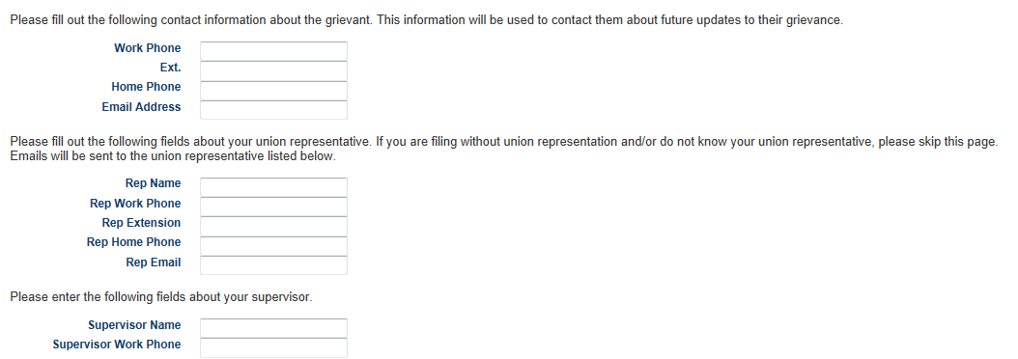
Grievant and/or local union representative may enter additional contact information if:
1) they are not the creator and wish to receive email notifications; and/or ;
2) want notifications to go to an email address other than one on record
Notes:
The grievant and/or local union representative should enter additional contact information if : 1) they are not the creator and wish to receive email notifications; and/or ; 2) they want notifications to go to an email address other than one on record.

Slide 19
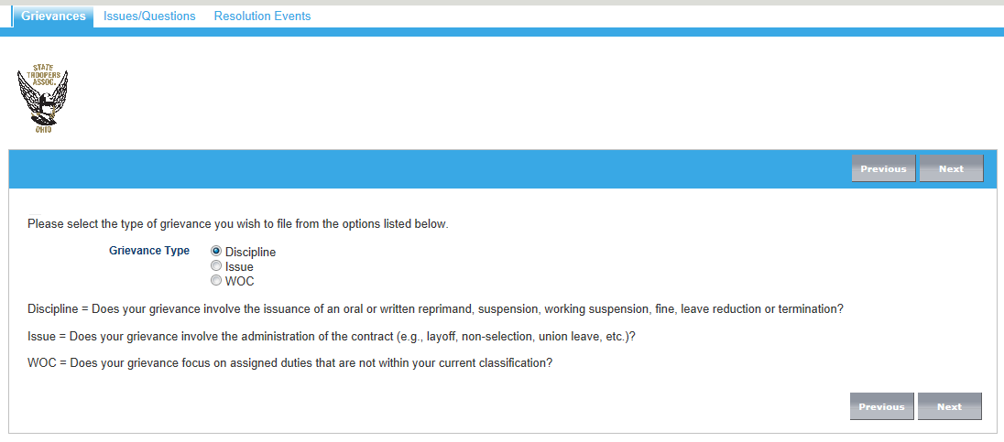
User must indicate Grievance Type
Discipline
Issue
Working out of Class
Notes:
The user will then need to select the type of grievance he or she is filing.
Only one type of grievance may be selected: Discipline, Issue or Working out of Class.

Slide 20
If Grievance Type selected was “Discipline” - must enter specific type of discipline:
Verbal/Oral Reprimand
Fine
Suspension
Working Suspension
Leave Reduction
Demotion
Termination
Notes:
If Grievance Type selected is “Discipline” the user must enter specific type of discipline.
Please note that if a type of discipline is selected that is not contractually allowed for that union, the system will not allow the grievance to be submitted.

Slide 21
If Suspension, Work Suspension, Leave Reduction or Fine was selected sub-type, user will be prompted to indicate number of days:
If Termination was selected sub-type, user will be prompted to indicate termination date:
Notes:
If Suspension, Working Suspension, Leave Reduction or Fine is selected as the sub-type, the user will be prompted to indicate the number of days..
If Termination is the selected sub-type, the user will be prompted to indicate the termination date.

Slide 22
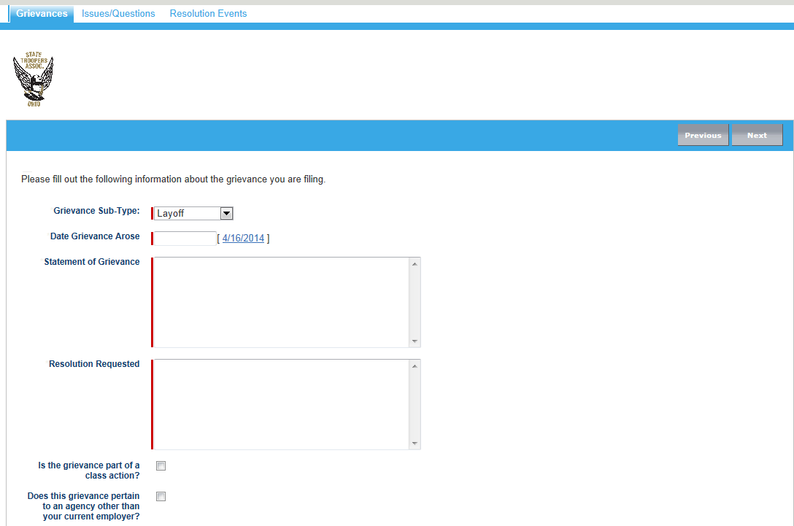
If Grievance Type selected was “Issue” - must enter sub-type
Issue – must enter type
Other
Layoff
Non-selection
Union Leave
Is this grievance a Class Action?
Does the grievance pertain to an agency other than current Employer?
Notes:
The system will modify the available sub-types if the Grievance Type selected is “Issue.”
The system will also ask if the grievance is a Class Action and if the grievance pertains to an agency other than current Employer of the grievant.

Slide 23
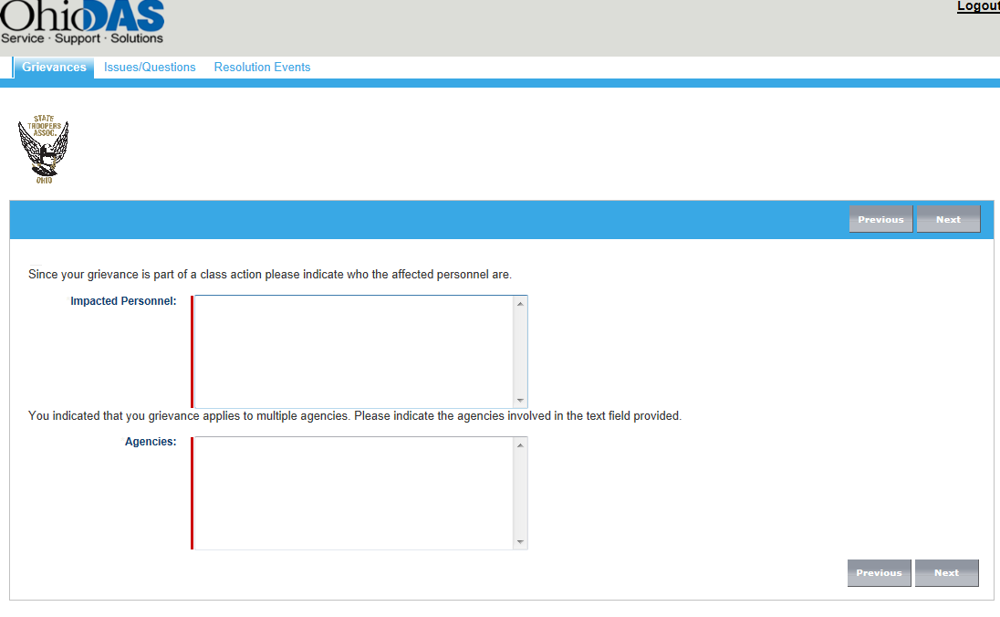
If “Is the grievance part of a class action?” was selected – user must indicate impacted personnel
If “Does the grievance pertain to an agency other than your current employer?” – user must indicate agency
Notes:
If the user indicates the grievance is part of a class action, he or she must indicate the impacted personnel.
If the user indicates the grievance pertains to an agency other than the grievant’s current employer, he or she must indicate agency that allegedly violated the contract.

Slide 24
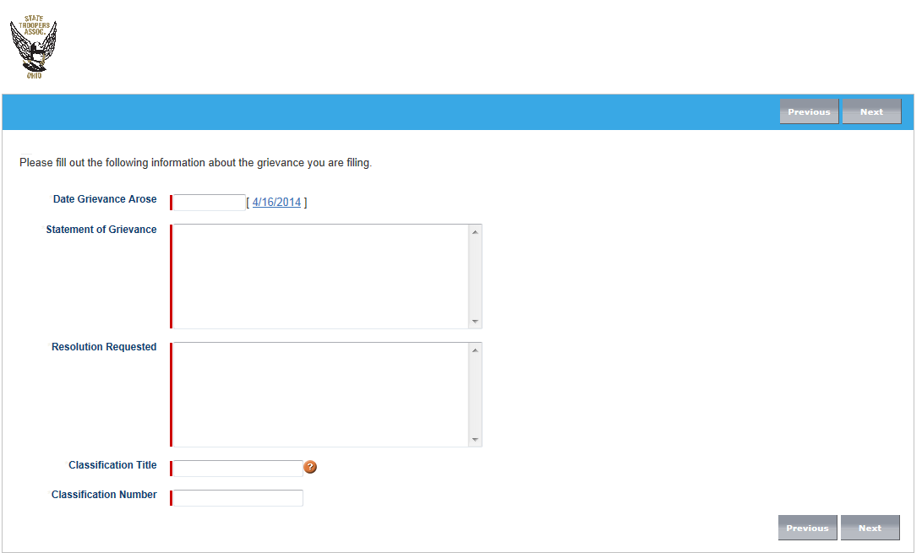
If Grievance Type selected was “Working out of Class” (WOC) – user must indicate classification title and number where the duties belong
Notes:
Similarly, if the Grievance Type selected is “Working out of Class” (WOC), the user must indicate the classification title and classification number where the duties allegedly belong.

Slide 25
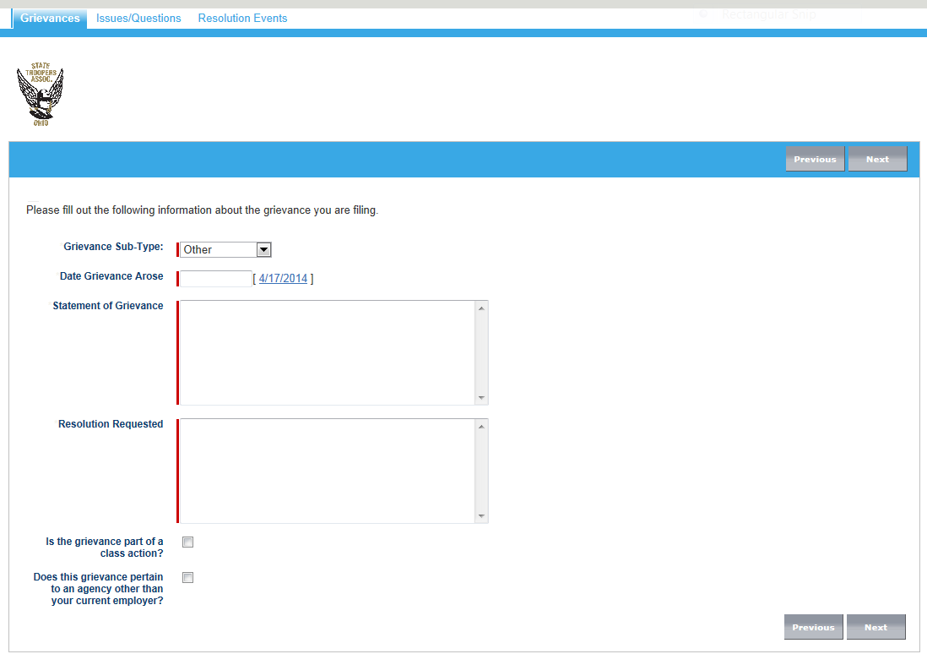
Date Grievance Arose – cannot be greater than current date (i.e., cannot use a future date)
Statement of Grievance - outline grievance details, free text, up to 32,000 characters
Resolution Requested - outline grievance details, free text, up to 32,000 characters
Notes:
Regardless of the type and sub-type of the grievance, all grievances must indicate the date grievance arose, the statement of the grievance and the resolution requested.
Please note that the date the grievance arose cannot be a future date.

Slide 26
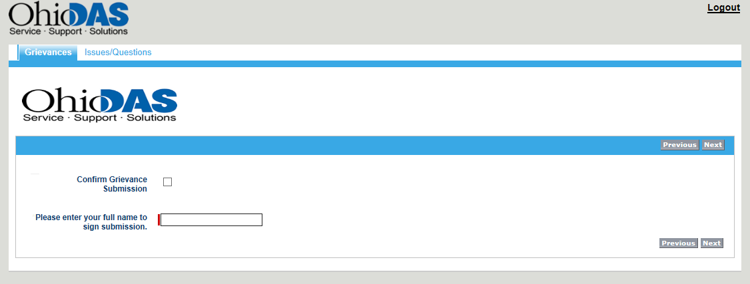
Confirm grievance submission
Enter full name to sign submission
Notes:
The user will be asked to confirm grievance submission and enter his or her full name.

Slide 27
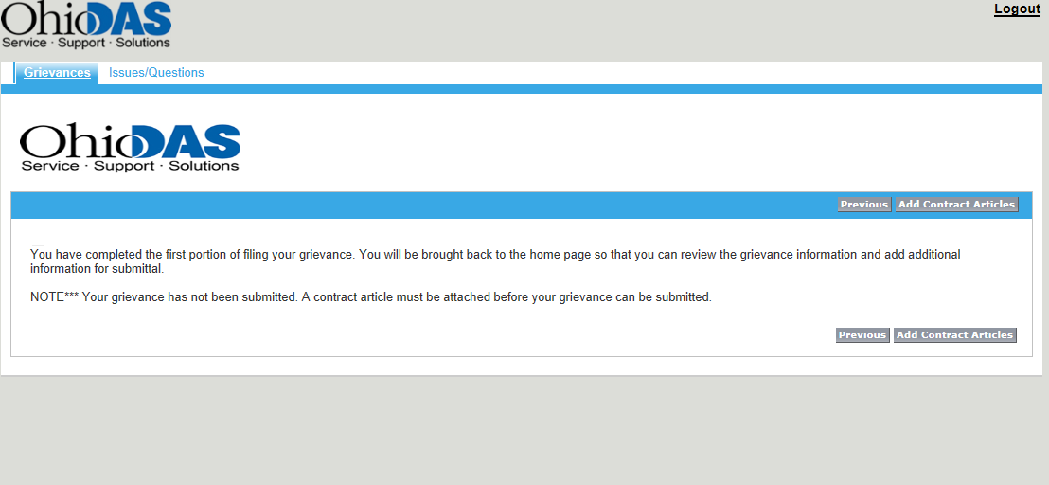
Attach all contract articles
Notes:
At this point, the user will be notified that he or she has completed the first portion of the grievance and will be given an opportunity to review and edit prior to submission.
The user will also be advised that the grievance has not yet been submitted and that at least one contract articles must be attached prior to submission.

Slide 28
Articles
Select articles
Attach articles
Notes:
The user may then select the articles and specific sections that have been violated.
The user may attach as many articles and sections necessary to reflect the alleged contract violation.

Slide 29
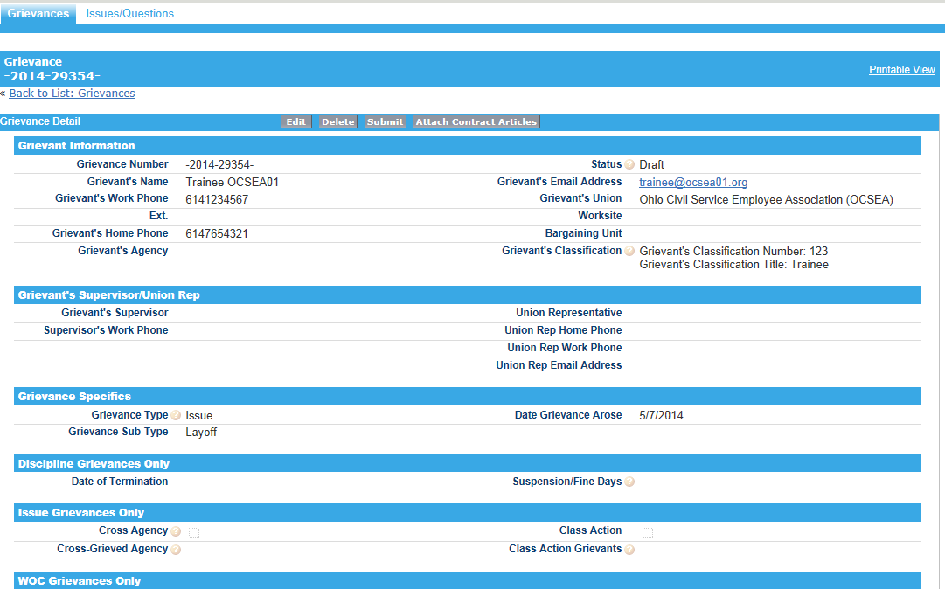
Once Contract Articles are selected, user will be taken to “Grievance Detail Screen”
Review Information
Status – Will remain in “Draft” status until user submits
Edit, Delete, Submit or Attach Contract Articles
Notes:
Once Contract Articles are attached, the user will be taken to the “Grievance Detail Screen.”
The user can then review all information that has been entered or auto-populated from the OAKS record of the grievant.
The user may choose to Edit, Delete, Submit or Attach additional contract articles.
Please note that the status will remain as “Draft” until user chooses to submit the grievance.

Slide 30
Grievance Detail
Grievant Information:
Grievance Number
Automatically assigned (e.g., DPS-2014-04347-01)
Agency – Year – Sequential Number – Bargaining Unit
Case numbers assigned upon initial draft
Unavailable if grievance is deleted before submission
Resets beginning of each calendar year
Grievant’s Name, Work Phone, Agency, Email Address, Union, Worksite, Bargaining Unit & Classification auto-populates
Grievant’s Supervisor and/or Union Representative & Phone - if entered when filing
Grievance Specifics – Type and Sub-type, Date Grievance Arose
Relevant information regarding number of suspension days, termination date and/or grieved classification
Notes:
Prior to submitting the grievance, the user should carefully review all the grievance information to include the Grievance Number.
The grievance number will be automatically assigned and is comprised of the three letter Agency acronym, the year in which the grievance was filed, the Statewide Sequential Number and the Bargaining Unit of the Grievant.
Please note that the Statewide Sequential Number is a number assigned upon initial draft. This number will be unavailable even if the grievance is deleted before submission. This number resets at the beginning of each calendar year.
The user should also carefully review the Grievant’s Name, Work Phone number, Agency, Work Email Address, Union, Worksite, Bargaining Unit & Classification as these fields will auto-populate based upon information pulled from OAKS.
Additionally, the Grievant’s Supervisor and/or Union Representative and their Work Phone Numbers may be seen if any or all of these fields were completed when filing the grievance.
Furthermore, the Grievance Type and Sub-type, the Date the Grievance Arose and relevant information regarding the number of suspension days, termination date and/or grieved classification can be reviewed at this time.

Slide 31
Grievance Detail
Statement of Grievance:
Statement of Grievance
Resolution Requested
Contract Articles Links:
Lists all grievances allegedly violated
Notes & Attachments
Attach relevant documents
Must be scanned to computer you are working from
Schedules, OT Sign up sheets, etc.
Submission:
Indicates date grievance was submitted, signature and affirmation
System Information:
Created by, date, time
Last Modified by, date, time
Notes:
The Statement of Grievances and Resolution Requested as well as the Contract Articles cited should also be reviewed and confirmed at this time.
At this point, the user may also choose to attach relevant documents under the Notes & Attachments section of the grievance screen. These documents must be scanned to the computer the user is working from and may include Schedules, Overtime Sign up sheets, or other documentation that supports the grievance.
Additional fields will populate upon Submission to include submission date, when the grievance was created and last modified and by whom.
Please note that the submission date is the official date of record to determine if the grievance was filed in a timely manner.

Slide 32
Draft: Will reflect “Draft” and “New Grievance” until user chooses to submit
Management can not see
Union/grievant may delete if they choose not to submit
Notes:
At this point, if the user were to navigate to the Grievances Home page, he or she would see that the grievance is listed in “Draft” status and the record type indicates the grievance is a “New Grievance.”
It is important to note that the agency Human Resources designee has not been notified of a new grievance and the grievance cannot be viewed by that designee.
When the grievance is in draft mode, the user may still choose to delete the grievance.

Slide 33
Submitting a Grievance
User must confirm they wish to submit
As long as no validation checks fail, user will be navigated back to the Grievances Home Tab
Notes:
When a user is ready to submit a grievance, they will simply click on the “Submit” button at the top of the Grievance Detail screen.
The system will prompt the user to confirm that he or she is ready to submit the grievance.

Slide 34
Submitting a Grievance
User can see the grievance is now listed as “Open” and the applicable step
Delete option is removed
Union representatives and/or grievant must withdraw if he/she has the authority to close
Notes:
Upon submission, the user will be navigated back to the Grievances Home screen.
The user can now see the grievance is listed as “Open” and the applicable step in the grievance appeal process.
The Delete option is now removed.
Should the user choose to close the grievance at this time, and has proper authorization to do so, they will open the grievance and select the withdraw button.

Slide 35
Example Email Notification of Submission
If a union representative is filing on behalf of someone, the member will only receive notice that a grievance has been filed on their behalf if the representative entered the member’s email address in the initial steps of the grievance.
Representatives are encouraged to include the Grievant’s email address.
Notes:
Upon submission of a grievance, email notifications will go to the grievant’s agency Human Resources or Labor Relations designee in the agency. The same email will go to the user, also known as the creator of the grievance as well as the grievant’s union headquarters or chapter president.
Please know that if a union representative is filing on behalf of someone else, the bargaining unit employee will only receive notice that a grievance has been filed on their behalf if the representative entered the member’s email address in the initial steps of the grievance.
As such, representatives are encouraged to include the Grievant’s work or personal email address.

Slide 36
Setting a Meeting
Upon notification, Labor Relations designee will log in and review the grievance (read only)
Labor Relations designee will coordinate a meeting date with union representative
Email notification that meeting has been scheduled will be sent to all relevant parties
Union representative and/or grievant should coordinate attendance and release with agency labor relations
Notes:
Upon notification, the agency Human Resources or Labor Relations designee will log in and review the grievance.
The grievance detail is now read only.
The agency Human Resources or Labor Relations designee will coordinate a meeting date with the union representative and/or the grievant and enter the date of the meeting into the system.

Slide 37
Example Email Notification of a Meeting
Notes:
An email notification indicating that a meeting has been scheduled will be sent to all relevant parties.
Union representative and/or grievant should continue to coordinate attendance and release with the agency Human Resources or Labor Relations designee as well as their supervisor.

Slide 38
Example Email Notification of a Meeting Extension
Notes:
Should the parties need to reschedule the meeting, the agency designee will enter the new date into the system and an email notification will go to all relevant parties.

Slide 39
Writing a Response
After the grievance has been discussed, the labor relations designee will issue a response
Management/Arb Response Detail:
Confirm attendance
Confirm articles violated
Summarize parties’ arguments
List procedural defects
Outline finding
Management/Arb Response:
Settled (signed paperwork attached)
Granted (specific remedy is outlined)
Denied
Management Respondent
Notes:
After the appeal meeting has been conducted and the grievance has been discussed, the agency Human Resources or Labor Relations designee will issue a response.
The response will include the Management Response Detail. This will typically confirm those who were in attendance, the articles cited in the grievance or during the meeting, lists any procedural defects that may have been argued, summarize the parties’ arguments and outline the finding.
The response will include an overall response of one of the following:
Settled. When a grievance is settled, the supporting paperwork will be attached;
Granted. When a grievance is granted, the specific remedy will be outlined in the response section; or
Denied. When a grievance is denied, the detailed response should outline the arguments submitting at the meeting.
The name of the person responding to the grievance will also be listed in the response.

Slide 40
Example Email Notification of Management Response
Notes:
Upon completion and submission of the management response, an email notification will go to all relevant parties.

Slide 41
Grievance Resolution
Granted
Management will outline specific remedy offered in the management response
Grievance response will reflect “Granted”
The grievant or Union will have up to five calendar days to appeal if remedy is not acceptable
If no action is taken (i.e., not appealed), remedy offered will be considered acceptable and case will close
Settled
Management will upload signed document that supports closure
Grievance response will reflect “Settled”
Grievance status will change to “Closed”
Denied
Management denies any violation of the contract and the grievance will remain open
Union may choose to appeal to subsequent step of the grievance appeal process if the grievance is eligible
Withdrawn
Only available to union members and representatives as determined by union Headquarters
Grievance status will changed to “Closed”
Notes:
There are four ways in which a grievance may be closed:
1) Granted
The agency Human Resources or Labor Relations designee will outline a specific remedy and the grievance response will reflect “Granted”
The grievant or Union will have up to five calendar days to appeal if remedy is not acceptable
If no action is taken (i.e., the grievance is not appealed within five calendar days), the remedy offered will be considered acceptable and the grievance status will change to “Closed”
2) Settled
The agency Human Resources or Labor Relations designee will upload the signed settlement and the grievance response will reflect “Settled”
The grievance status will change to “Closed”
3) Denied
The agency Human Resources or Labor Relations designee may deny any violation of the contract occurred and the grievance response will reflect “Denied”
The grievance status will remain as “Open” unless there are no additional appeal steps. When no additional appeal steps are available, the status will change to “Closed”
The grievant or Union may choose to appeal the grievance to the next step of the grievance appeal process if additional appeal steps are available
4) Withdrawn
The grievant or Union may choose to withdraw the grievance
This option is available to union members and representatives as determined by union Headquarters
If withdrawn, the grievance status will change to “Closed”

Slide 42
Appeal Activation
1) Upon Denial
2) If meeting date, meeting extension date or response has been entered within 15 days of submission at step 1.
Only applicable to OCSEA grievances sub-types that include reprimand or issues not pertaining to layoff, non-selection or union leave.
3) If no meeting date, meeting extension date or response has been entered within 50 days of submission or appeal at step 2.
Cases will close if no action has been taken within 30 days of activation of the appeal button.
Notes:
There are three ways in which a grievance may be appealed to the next step of the appeal process:
1) Upon Denial
2) If no meeting date, meeting extension date or response has been entered within 15 days of submission at step 1 of the grievance appeal process. Please note that Step 1 is only applicable to OCSEA grievances sub-types that include reprimand or an issue not pertaining to layoff, non-selection or union leave.
3) If no meeting date, meeting extension date or response has been entered within 50 days of submission or appeal at step 2 of the grievance appeal process.
All cases will close if no action has been taken within 30 days of activation of the appeal button.

Slide 43
Modifying Grievances
Grievance forms cannot be modified once submitted unless the grievance is eligible for two agency appeal meetings
OCSEA Issue grievances not pertaining to layoff or non-selection
OCSEA Written reprimands
The union may make modifications to the remedy requested or articles cited when appealing the grievance from step 1 to step 2
If additional contract articles are cited or remedy is modified during the step 2 meeting, union must notify labor designee during the meeting and submit attachment to grievance within 24 hours of step 2 meeting
Notes:
Grievance forms cannot be modified once submitted unless the grievance is eligible for two agency appeal meetings.
Only OCSEA grievance sub-types of “Written Reprimand” and Issue grievances “Not pertaining to layoff or non-selection” are eligible for two agency appeal meetings.
For these OCSEA grievances, the Union may make modifications when appealing the grievance from step 1 to step 2. However; modifications to the grievance form are limited to the remedy requested and articles cited.
All other grievances go directly to “Step 2” and have one agency level meeting.
If additional contract articles are cited or the remedy is modified during the step 2 meeting, the employee or union must notify the Human Resources or labor relations designee during the meeting and submit an attachment to grievance detail screen within 24 hours of step 2 meeting.

Slide 44
Mediation and Arbitration

Slide 45
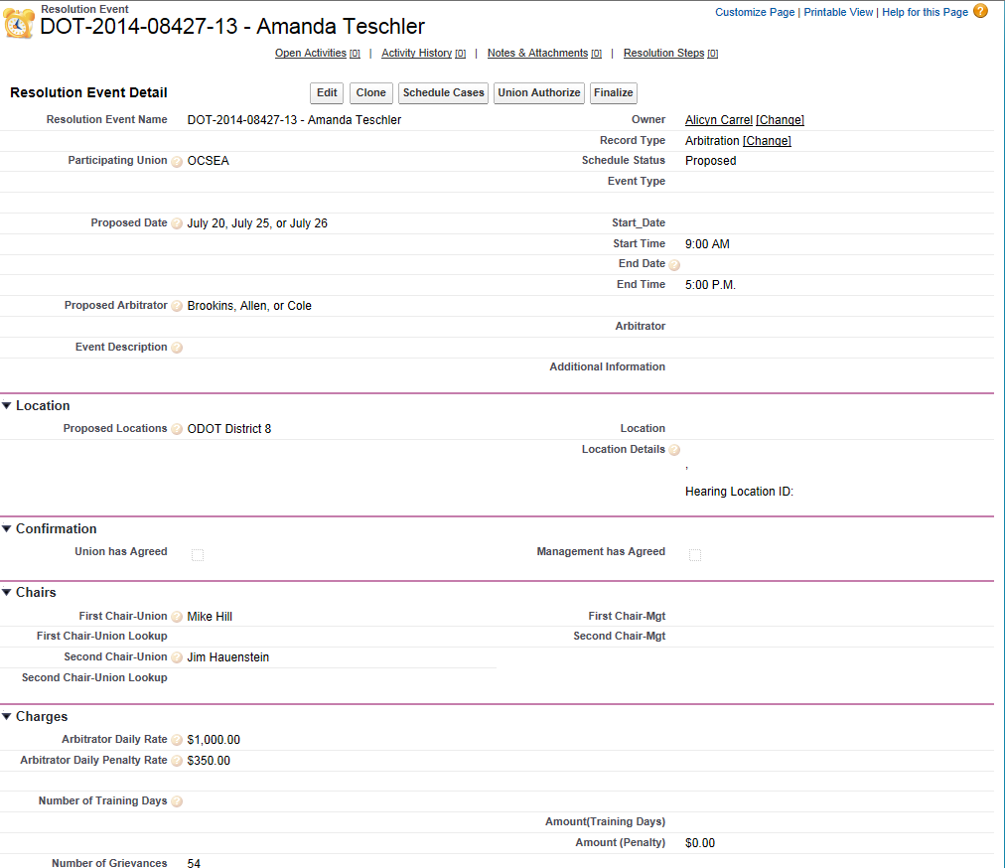
Scheduling Proposal from the Union
Grievance Number and Name
Union Headquarters will submit mediation and arbitration requests
Grievance Number and Name
OCB Scheduler
Proposed Arbitrators
Union First Chair and Union Second Chair
Resolution Event Proposal from the Union
Notes:
If a grievance is appealed to the Office of Collective Bargaining, Union Headquarters may submit requests for specific cases to be scheduled for mediation and/or arbitration.
When a mediation or arbitration is confirmed by all parties, the system will generate notice to the impacted personnel.
Changes in the status of the case as a result of mediation or arbitration will also generate email notifications to relevant parties.

Slide 46
Issues & Questions

Slide 47
Issues/Questions
Additional tab available to union representatives to notify system administrator of functionality concerns with the system
Only intended to trouble shoot issues related to use of the system or add/remove representatives
Click the Issues/Questions Tab, Create New Issue/Question
Notes:
Please note that an additional tab will be available to union representatives to notify the system administrator of any functionality concerns with the system.
This is only intended to trouble shoot issues related to the functionality of the system or add/remove union representatives. This should not be used to discuss the merits of a specific grievance as it will be routed to the system administrator and not to union personnel.
Should a bargaining unit member or representative encounter issues with the system, please request the union representative or union headquarters submit an issue.
In order to do this, the user will need to navigate to the “Issues/Questions” tab then select “Create New Issue/Question.”

Slide 48
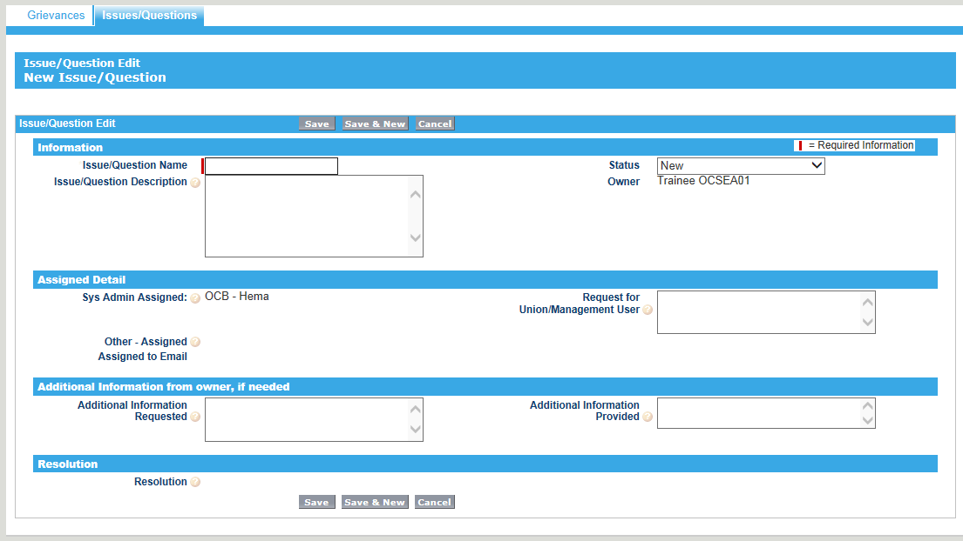
Provide short name of issue and detailed description of the question or issue
Click Save
Notes:
The user should provide a name that quickly summarizes the concern and allows for later searches based upon this name.
The user should also provide a detailed description of the issue. This will allow the system administrator to quickly understand the concern and/or research and assign the issue to the appropriate person where needed.

Slide 49
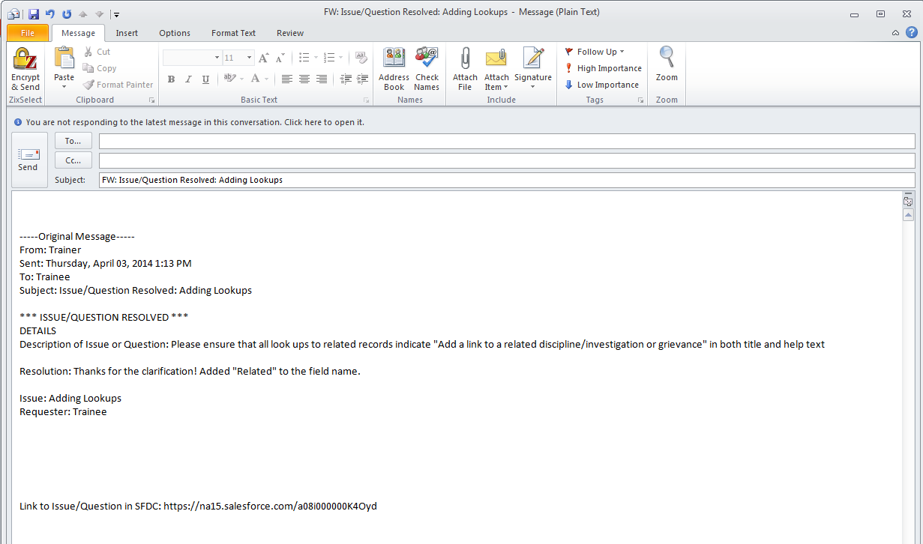
Notification e-mail that issue/question sent directly to system administrator.
Notification e-mail that issue/question resolved.
Notes:
Upon submission of Issue or Question, an email notification will be sent directly to the system administrator. More importantly, an email notification will be generated to the person submitting the issue. The email will request any additional information needed and/or advise of the resolution.

Slide 50
Thank You
Notes:
Thank you for taking the time to learn about OHgrievance.

